Slide 1
Crowdsourced Civic Issue Reporting and Resolution System
CSE7302 – University Project
Review-5
Batch Number: COM_15
Under the Supervision of,
Ms. Babitha S
School of Computer Science and Engineering
Presidency University
Roll Number | Student Name
20221COM0084 | VISHNU M
20221COM0096 | R AKASH
20221COM0099 | JAGADISH T S
Name of the Program: B.TECH CSE
Name of the HoD: Dr.Gopalkirshna Shyam
Name of the Program Project Coordinator: Ms.Sumita Guddin
Name of the School Project Coordinators: Dr.Samapth A K & Dr.Geetha Arjunan

Slide 2
Content
Problem Statement
Abstract
Literature Survey
Objectives
Existing Methods and Drawbacks
Proposed Method & Feasibility Study
Architecture Diagram
Modules
Software Details
Timeline (Gantt Chart)
References

Slide 3
Problem Statement Number : SIH25031
Problem Description:
Citizens frequently encounter civic issues such as potholes, garbage overflow,
water leakage, broken streetlights, and sanitation problems.
Existing complaint mechanisms are fragmented, manual, or lack transparency
and real-time tracking. This results in delayed resolution and poor accountability.
There is a need for a centralized, crowdsourced digital platform that allows citizens
to report civic issues and enables authorities to efficiently monitor and resolve them.

Slide 4
ABSTRACT
The rapid growth of urban populations has created increasing pressure on city infrastructure, resulting in frequent civic issues such as damaged roads, electrical failures, water pipe leakages, and waste management problems. Existing complaint mechanisms lack transparency, accountability, and real-time feedback.
This project presents a full-stack civic issue management system consisting of:
A Flutter mobile application for citizens to submit geo-tagged, photo-evidenced complaints
A React.js web portal for government administrators with AI-powered priority detection
A department portal for field staff to update work status and upload resolution proof
An Appwrite BaaS backend eliminating the need for custom server infrastructure
A gamification system awarding points to encourage genuine citizen participation
A proof-based resolution system where departments upload after-work photos visible to citizens
The AI priority engine analyses four factors — keyword severity, time of submission, nearby critical facilities via Google Maps Places API, and road classification via Google Maps Geocoding API — to automatically classify each report as High, Medium, or Low priority without requiring a machine learning server.

Slide 5
LITERATURE SURVEY
Literature Survey Summary :
1) Ilamaran et al. (2025) – Crowdsourced Civic Issue Reporting and Resolution System
(IJRPR – BASE PAPER)
Proposes a cloud-based, crowdsourced platform for reporting civic issues
Citizens upload images, descriptions, and geotagged locations
Uses machine learning for issue categorization, duplicate detection, and prioritization
Provides real-time tracking and a centralized dashboard for authorities
Limitation:
High system complexity
Heavy ML dependence increases computational cost
Not optimized for serverless / free-tier cloud deployment
2) Kurian et al. (2026) – SmartReporter: A Crowdsourced Complaint Resolution System
(IJERT)
Web-based civic issue reporting platform
Uses YOLOv8 / YOLOv9 deep learning models for image-based issue detection
Automatically classifies potholes, garbage, streetlight faults
Provides real-time dashboards and analytics
Limitation:
Requires GPU resources
High inference cost
Not feasible for student-level or free-cloud deployment

Slide 6
LITERATURE SURVEY
3) Walwadkar et al. (2022) – Smart Civic Issue Reporting System
(IJARSCT)
Android-based complaint reporting system
Uses CNN + RNN hybrid model
Applies NLP (SVM) to detect complaint severity
Uses GPS and camera for evidence collection
Limitation:
Over-engineered ML architecture
Requires large labeled datasets
Android-only; not web or cloud-native
4) Shukla et al. (2024) – Civic Complaint Registration Application for Urban/Rural Areas
(JETIR)
Android application for civic complaint registration
Uses image processing (Faster R-CNN) for issue categorization
Integrates Google Maps API for geolocation
Provides admin and user dashboards
Limitation:
Mobile-only system
High image-processing overhead
Limited scalability discussion

Slide 7
LITERATURE SURVEY
5) Meshram et al. (2025) – Smart Civic Issue Reporting, Resolution & Waste Recycle Reward System
(IJARESM)
Full-stack web-based civic issue platform
Adds AI-generated descriptions
Introduces waste recycling and reward-based gamification
Encourages citizen participation using points and leaderboards
Limitation:
Very broad scope
Increased system complexity
Reward focus diverts attention from core resolution workflow
6) Walwadkar et al. (2022) – Smart Civic Issue Reporting using CNN–RNN & NLP
(IJARSCT – Extended ML Focus)
Uses CNN–RNN hybrid for image-based issue analysis
Applies SVM-based NLP for severity detection
Automatically routes complaints to departments
Limitation:
High training and maintenance cost
Not suitable for low-resource environments
Difficult to deploy on free cloud platforms

Slide 8
LITERATURE SURVEY
7) Mohanty et al. (2025) – Crowdsourced Complaint Resolution using Geotagging
(IRJMETS)
Flutter-based mobile application
Citizens report civic issues with GPS tagging
Uses community upvoting for complaint validation
Ticket-based escalation mechanism
Limitation:
Limited civic categories (mostly road issues)
No intelligent automation
Mobile-app dependency

Slide 9
Objectives
Primary Objectives:
Develop a cross-platform mobile application enabling citizens to submit civic complaints with photo evidence and GPS location
Build an AI-powered priority detection engine that automatically classifies complaints as High, Medium, or Low urgency using multi-factor analysis
Create a web-based administrative portal for government officials to review, analyse, and assign complaints to appropriate departments
Implement a department portal allowing field staff to update work status and upload photographic proof of completed work
Design a proof-based resolution system where before and after images are visible to citizens in the mobile app
Integrate a gamification mechanism through a points-based reward system to encourage responsible citizen participation
Deploy a scalable, serverless system using Appwrite BaaS requiring zero custom backend infrastructure

Slide 10
EXISTING METHODS & DRAWBACKS
Existing Methods :
Drawbacks :
No automated priority classification
No end-to-end workflow from submission to resolution
No photographic proof of completion
Existing System | How It Works | Drawbacks
Phone Helplines | Citizens call a number, operator logs manually | Slow, no tracking, dependent on operator availability
Email Complaints | Citizens email department | No tracking, ignored easily, no priority system
FixMyStreet / SeeClickFix | Web portal with map | No AI, no department workflow, no proof system
Government Mobile Apps (existing) | Basic complaint submission | No real-time tracking, no AI priority, no gamification
IoT Sensor Networks | Automatic detection via sensors | Very expensive, only detects specific issue types
Social Media Complaints | Twitter/Facebook posts | Unstructured, no official workflow, unreliable

Slide 11
PROPOSED METHOD
Proposed Solution :
Citizen Submits Report (Flutter App)
↓
AI Priority Engine Analyses Report
↓
Admin Reviews + Assigns to Department (React Portal)
↓
Department Works + Uploads Proof Photo (React Portal)
↓
Citizen Sees Before/After Images + Points Awarded (Flutter App)

Slide 12
FEASIBILITY STUDY
Technical Feasibility:
Flutter framework supports Android, iOS, and Web from single codebase ✅
Appwrite BaaS provides database, storage, and APIs without custom server ✅
Google Maps APIs available with free tier for development ✅
React.js web portal deployable free on Vercel ✅
Rule-based AI engine requires no ML server or training data ✅
Economic Feasibility:
Zero server cost — Appwrite Cloud free tier used ✅
Zero hosting cost — Vercel free tier for web portal ✅
Google Maps API — free for development usage ✅
Total infrastructure cost: ₹0 for development and testing ✅
Operational Feasibility:
Admin portal is browser-based, no installation required ✅
Mobile app installable as APK on any Android device ✅
Simple login system, no complex training required ✅
Departments only see their own assigned reports ✅

Slide 13
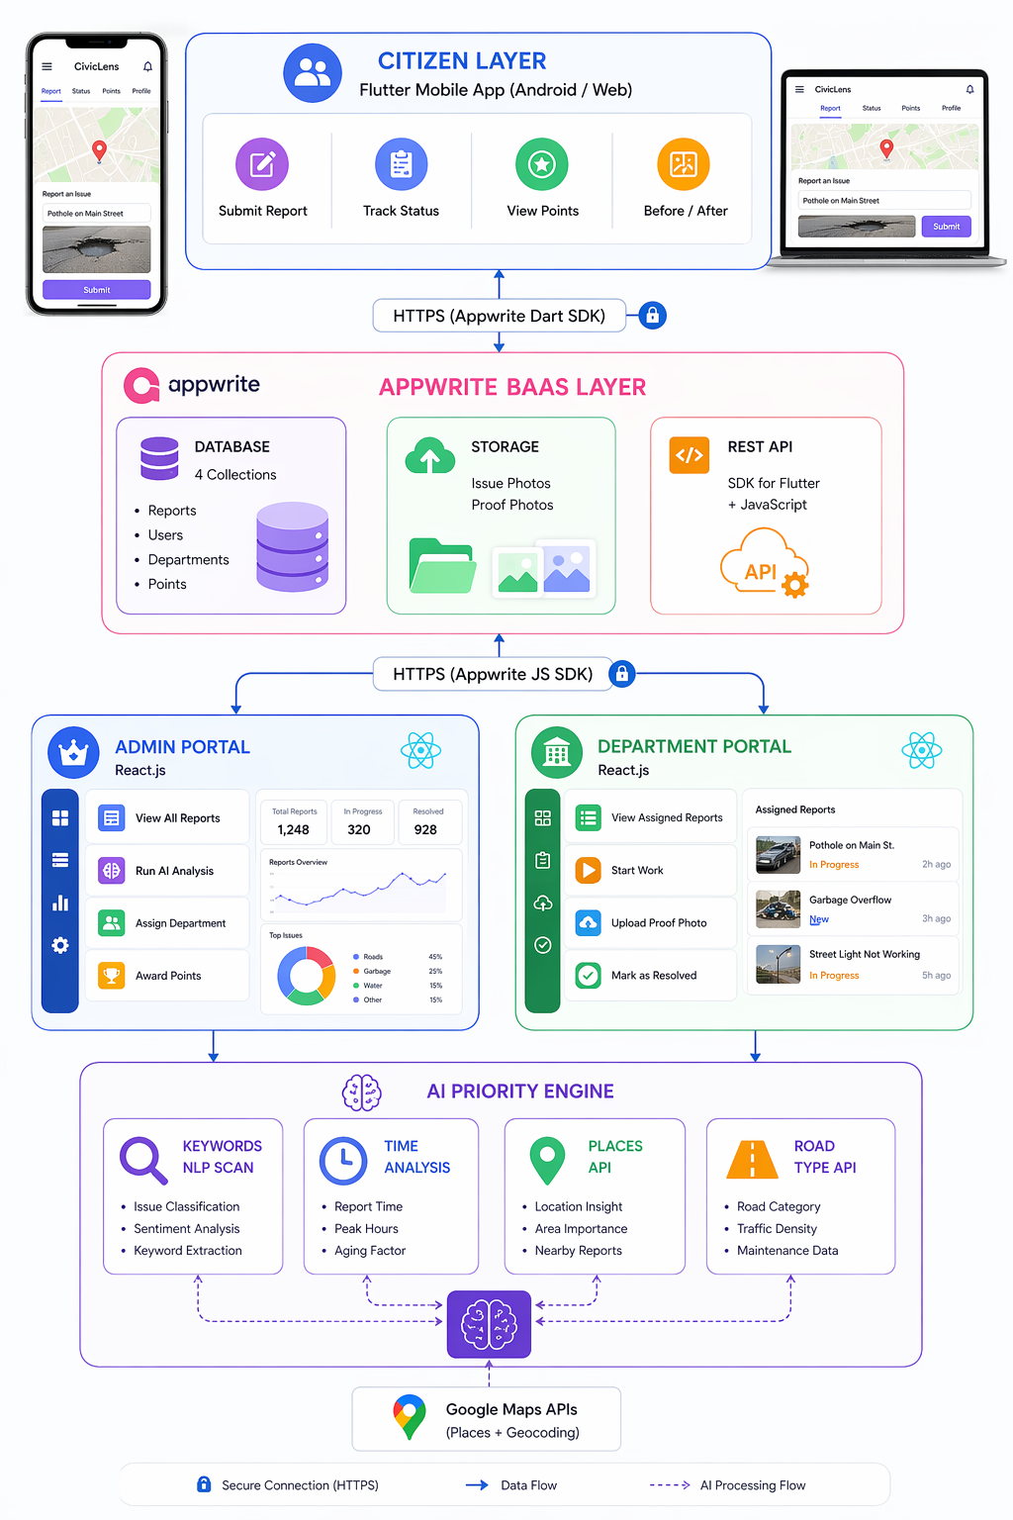
SYSTEM ARCHITECTURE DIAGRAM

Slide 14
MODULES
Module 1 — User Authentication Citizen login via Flutter, Admin/Dept via web. Sessions managed using SharedPreferences (mobile) and React Context (web).
Module 2 — Issue Reporting Users upload photo + GPS location. Report stored in Appwrite with pending status.
Module 3 — AI Priority Detection NLP + time + location analysis using Google Maps APIs to assign High/Medium/Low priority.
Module 4 — Admin Management Admin views reports, runs AI, assigns departments, and adds notes.
Module 5 — Department Workflow Departments update status: Assigned → In Progress → Resolved and upload proof images.
Module 6 — Proof-Based Resolution Before/After images stored and shown to users with verification badge.
Module 7 — Gamification Points awarded based on report validity and priority. User levels: New → Bronze → Silver → Gold.
Module 8 — Real-Time Tracking Users track reports through 4 stages with history and points dashboard.

Slide 15
SOFTWARE DETAILS
Software Stack :
Mobile App Flutter (Dart), Leaflet Maps, Geolocator, Image Picker, Appwrite SDK, SharedPreferences
Web Portal React.js, React Router, Appwrite JS SDK, React Context, Vercel
Backend Appwrite Cloud, NoSQL DB, Storage Buckets, Google Maps APIs, GitHub
Tools VS Code, Android Studio, Chrome, Postman, Appwrite Console

Slide 16
TIMELINE (GANTT CHART)
Activity | Jan | Feb | Mar | Apr
Problem Identification | ████
Review-1 (CA-01) | ███
Literature Survey & Design | ████
Review-2 (CA-02) | █
Frontend Development |  | ████
Review-3 (CA-03) |  | █
Backend & Integration |  |  | ████
Review-4 (CA-04) |  |  |  | █
Testing & Documentation |  |  |  | ███
Final Viva (CA-05) |  |  |  | █

Slide 17
References (IEEE Paper format)
[1] R. Ilamaran, M. Kavin Rajan, and S. Hareeswar, “Crowdsourced Civic Issue Reporting and Resolution System,” International Journal of Research Publication and Reviews (IJRPR), vol. 6, no. 11, pp. 8907–8910, Nov. 2025.
[2] K. Binu, K. Vinay, R. Midhun, V. P. Athul, and T. Shereena, “SmartReporter: A Crowdsourced Complaint Resolution System,” International Journal of Engineering Research & Technology (IJERT), vol. 15, no. 1, Jan. 2026.
[3] D. Walwadkar, J. Patil, M. Hussain, and S. Yadav, “Smart Civic Issue Reporting System,” International Journal of Advanced Research in Science, Communication and Technology (IJARSCT), vol. 2, no. 1, pp. 248–254, Mar. 2022, doi: 10.48175/IJARSCT-2659.
[4] S. G. Shukla, T. A. Bhandare, R. V. Bava, and I. S. Ahirrao, “Civic Complaint Registration Application for Citizens of Urban/Rural Areas,” Journal of Emerging Technologies and Innovative Research (JETIR), vol. 11, no. 5, May 2024.
[5] D. D. Meshram, R. R. Sahu, S. V. Pathak, K. P. Fukte, A. P. Darodkar, and G. S. Ramtekkar, “Smart Civic Issue Reporting, Resolution & Waste Recycle Reward System,” International Journal of All Research Education and Scientific Methods (IJARESM), vol. 13, no. 11, pp. 1377–1380, Nov. 2025.
[6] D. Walwadkar et al., “Civic Complaint Reporting Using Image Processing and NLP Techniques,” International Journal of Advanced Research in Science, Communication and Technology (IJARSCT), vol. 2, no. 1, Mar. 2022.
[7] A. Mohanty, P. Das, and S. Rout, “Crowdsourced Complaint Resolution System Using Geotagging,” International Research Journal of Modernization in Engineering Technology and Science (IRJMETS), vol. 7, no. 4, Apr. 2025.

Slide 18


